Slide 1
PROJECT ON AIRLINE RESERVATION SYSTEM
Veena M Shellikeri
2021-6141
EBEONO921446076

Slide 2
CONTENTS
Introduction
Requirements
Problem Statement
Advantages
Project Output
Conclusion

Slide 3
INTODUCTION
Airline Reservation System are system that allow an airline to sell their seats.
It contains information on book flight, flight checking and contains passenger records.
Airline reservation systems incorporate airline schedules,fare,passenger reservation and ticket records.

Slide 4
REQUIREMENTS
Front End: HTML,CSS,JS
Back End: Spring boot
Database: mysql8
Operating System: Windows10

Slide 5
PROBLEM STATEMENT
The project is to design and implement the software which helps the Airline System employees to issue reservation tickets for various Air flights and maintain the records of various passengers and provide quick services to the passengers.

Slide 6
MODULES
Registration
Login
Flight Searching
Flight Booking
Flight Checkin

Slide 7
ADVANTAGES
Easy to book tickets
Save time and money
Provides any information about flight
Mobile availability
Send automated tickets to customer by email
Customer support by calls and chats
Available for Domestic and International airlines

Slide 8
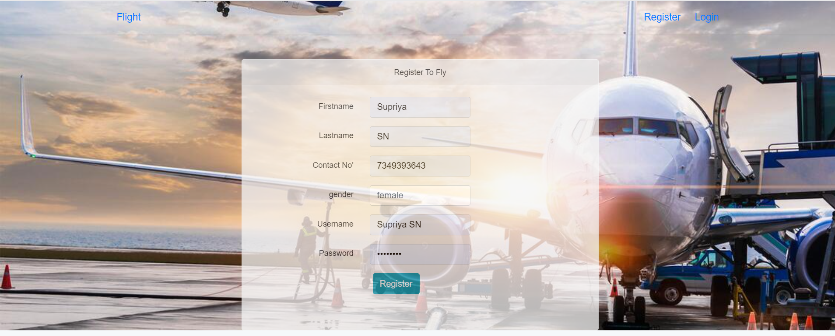
OUTPUT
Registration

Slide 9
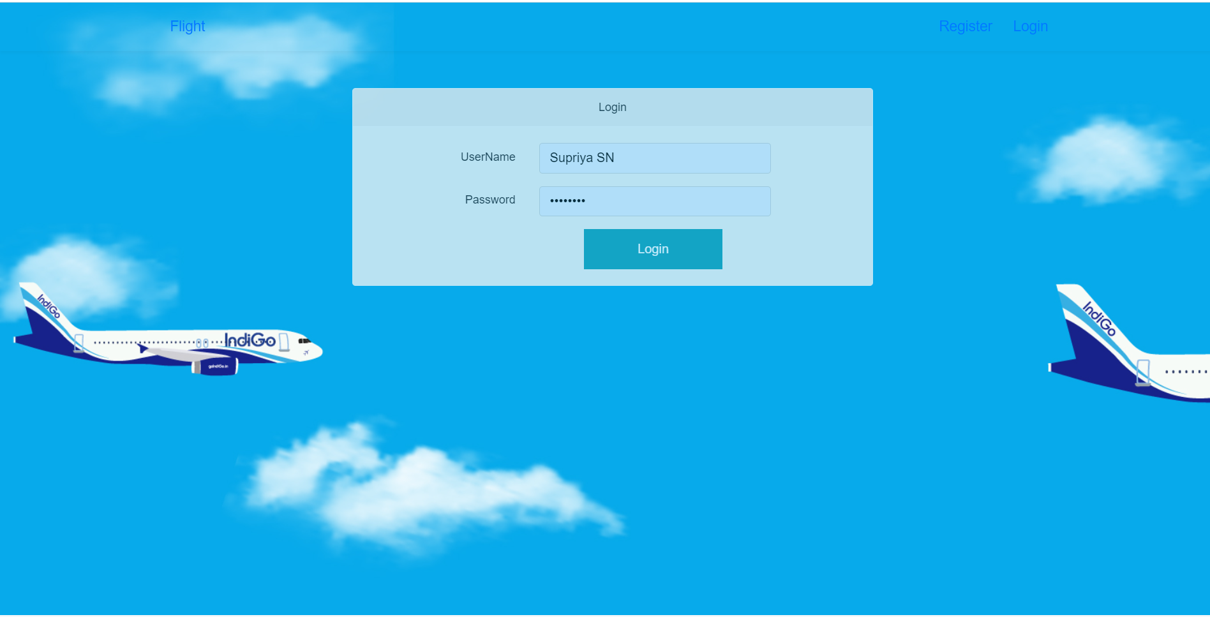
Login

Slide 10
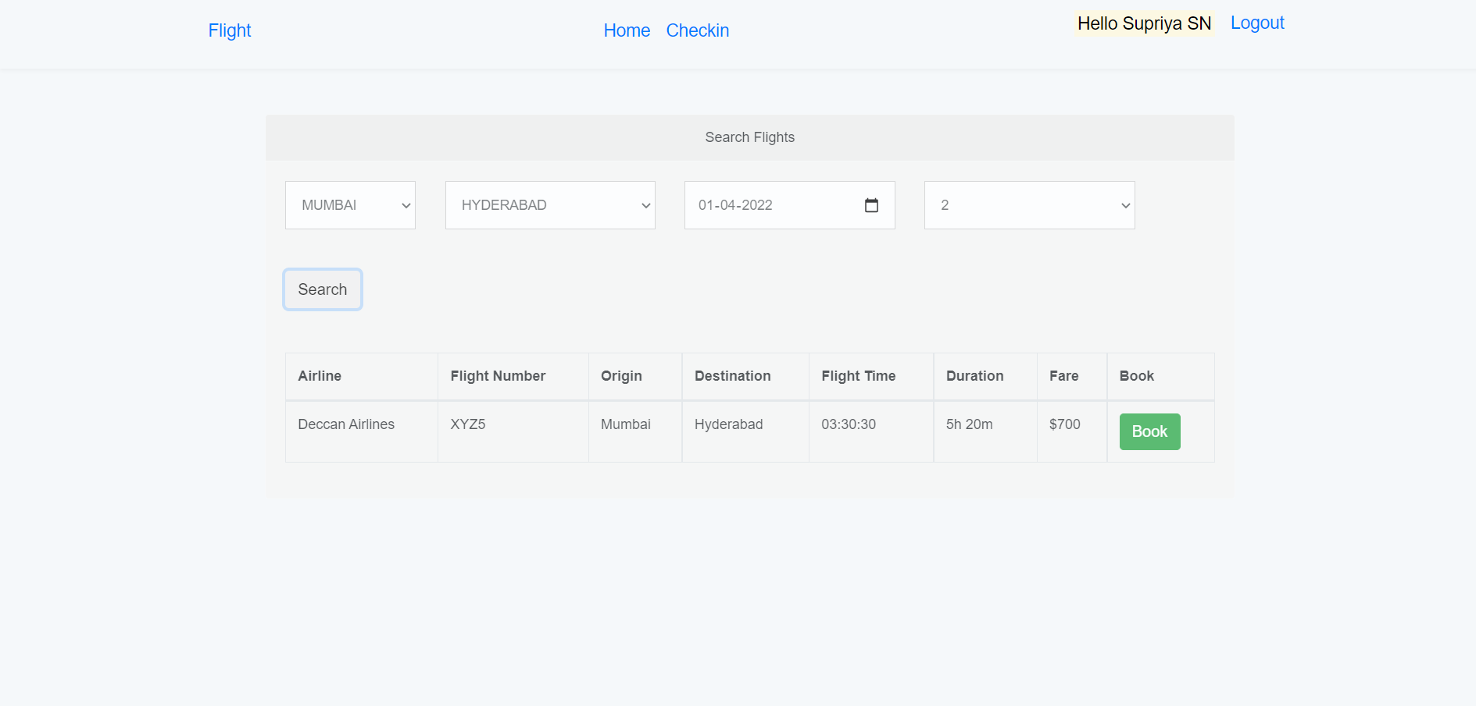
Search Flights

Slide 11
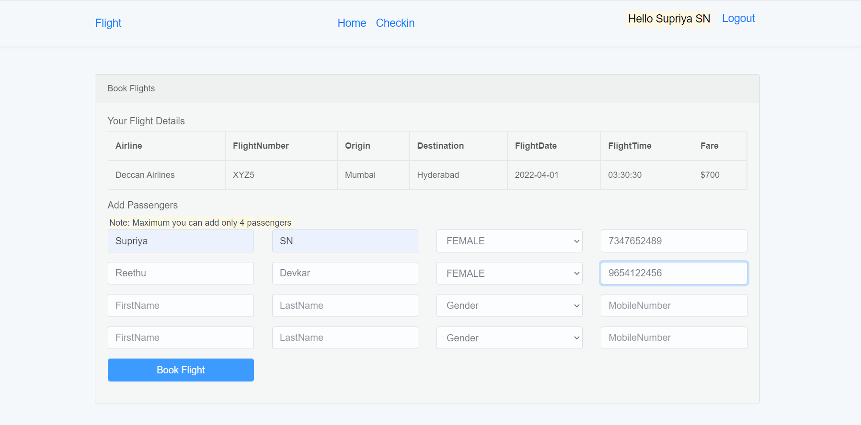
Book Flight

Slide 12
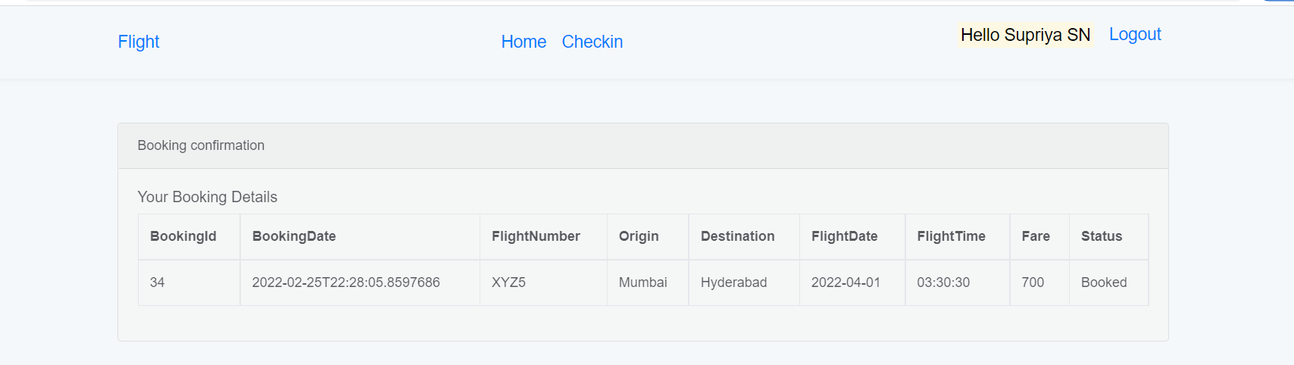
Booking Confirmation

Slide 13
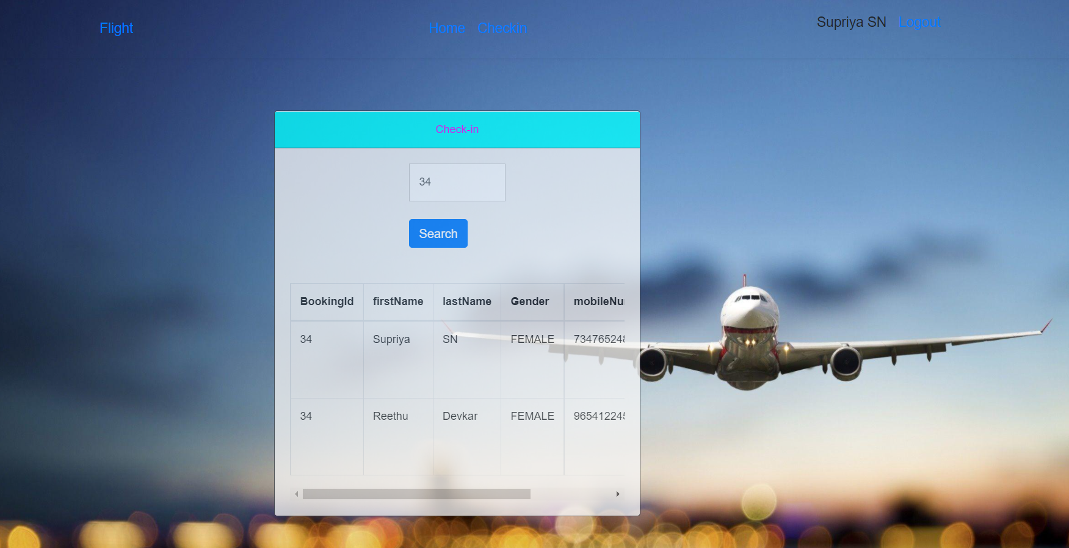
Checkin

Slide 14
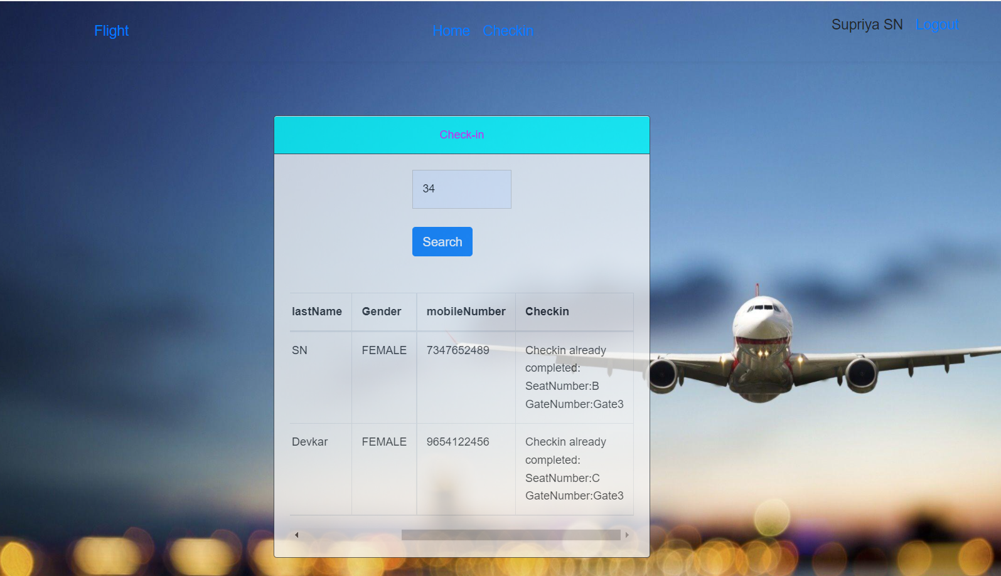
Checkin completed

Slide 15
CONCLUSION
It has been a pleasure to work on this challenging project
It helped to work on Front-end and back-end technologies
It gave me guidance to develop an project independently.

Slide 16
THANK YOU

